Slide 1
Digital Watermarking and Steganography - Mini Project SoSe 2019
Group 11: Sarah Böning, Anh Phoung Lee, Kai Gerrit Lünsdorf

Slide 2
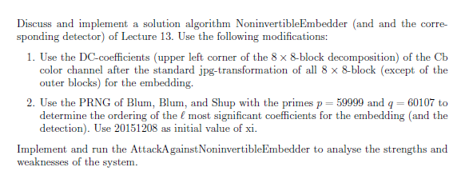
The Exercise

Slide 3
Our Interpretation
Implement 3 algorithms: Embedder, Attacker, Detector
Embedder: follow the given algorithm, but embed watermark on a random path (generated by BBS) of the upper left corner DCT coefficients of the Cb colour channel
Detector: Takes to watermarked & original images and computes the similarity
Attacker: tries to embed his own watermark
Analysis of the Watermarking System
Rightful Ownership Problem (Multiple public watermarked images)

Slide 4
Implementation - Embedder

Slide 5
Implementation - Detector

Slide 6
Implementation - Attacker

Slide 7
Analysis

